Slide 1
WebDesign for Ride 2 Dreams Private Limited.
By
R.Veeramanikandan.

Slide 2
Abstract:
This Web-site is Specially Designed for Bike Riders. Register and Ride to your Dream and Passion. First Time we introduced Female Riders , they can Show their talent. The main reason to introduce the Web-site is many rider's crash their Monster in roads because of doing Stunt and Race and we thought to reduce it by registering here and doing in a separate track with Safety Precautions it won't disturb Public. Rider's entering first to our Web-site just Register in Registeration Form, After Registering your profile just Log-In to See the features of our Web-site and races which are conducted. Start Your Journey Towards Dreams!!!

Slide 3
Technologies:
Website is Designed by Using HTML,CSS, JSTL ,EL and JS.
Implemented Struts Framework based on MVC Pattern.
Storing and Manipulating of Data by Using JPA.
Implemented I18N based on Struts Framework.

Slide 4
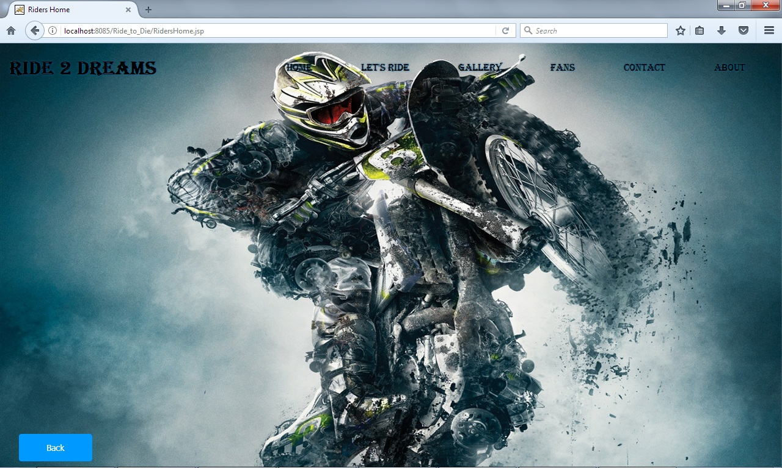
INDEX PAGE
Index Page is designed by using HTML and CSS.The page Contains
Navigation bar Which contains Home, Let’s Ride , Gallery ,Fans , Contact
and About.

Slide 5
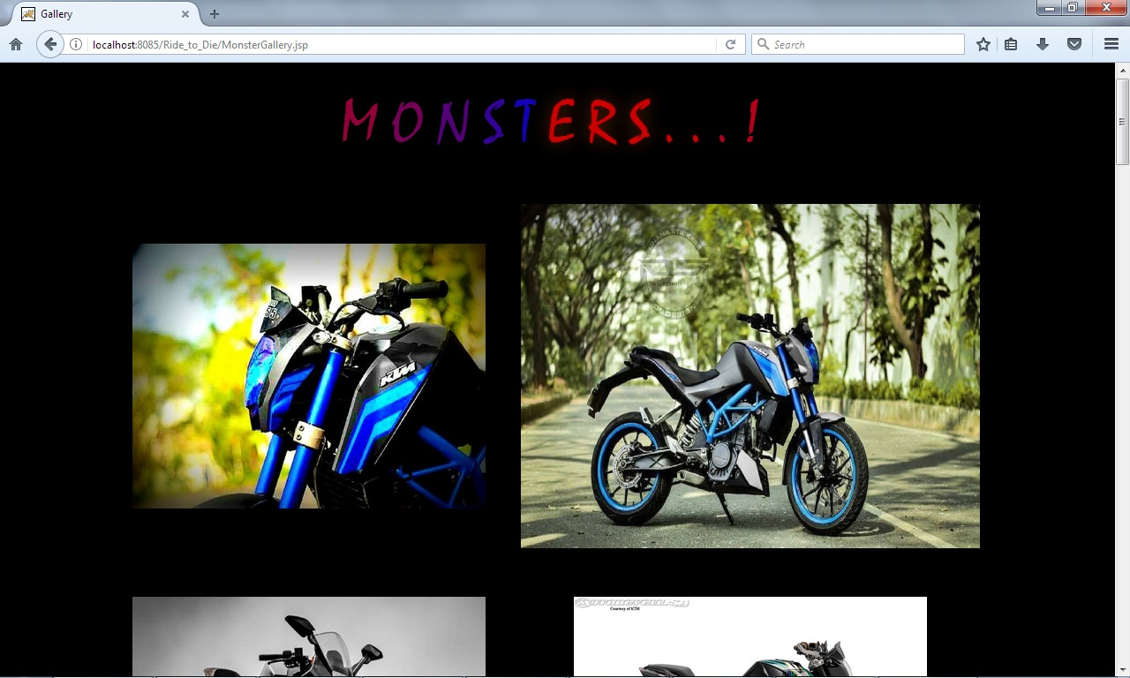
Gallery
Monster Page is designed for having Collection of Bike Images with
Automatic Zoom-in feature.

Slide 6
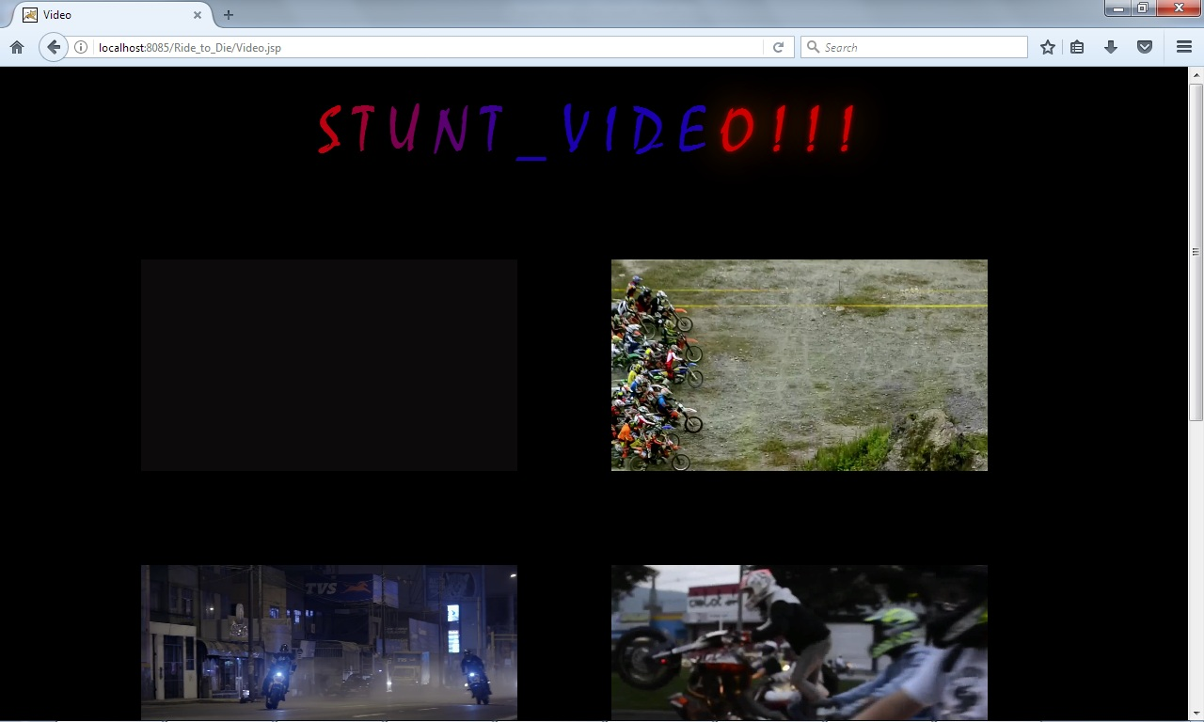
Videos
The Video Page consist of Collection of video by opening each and
Can play in a big screen .

Slide 7
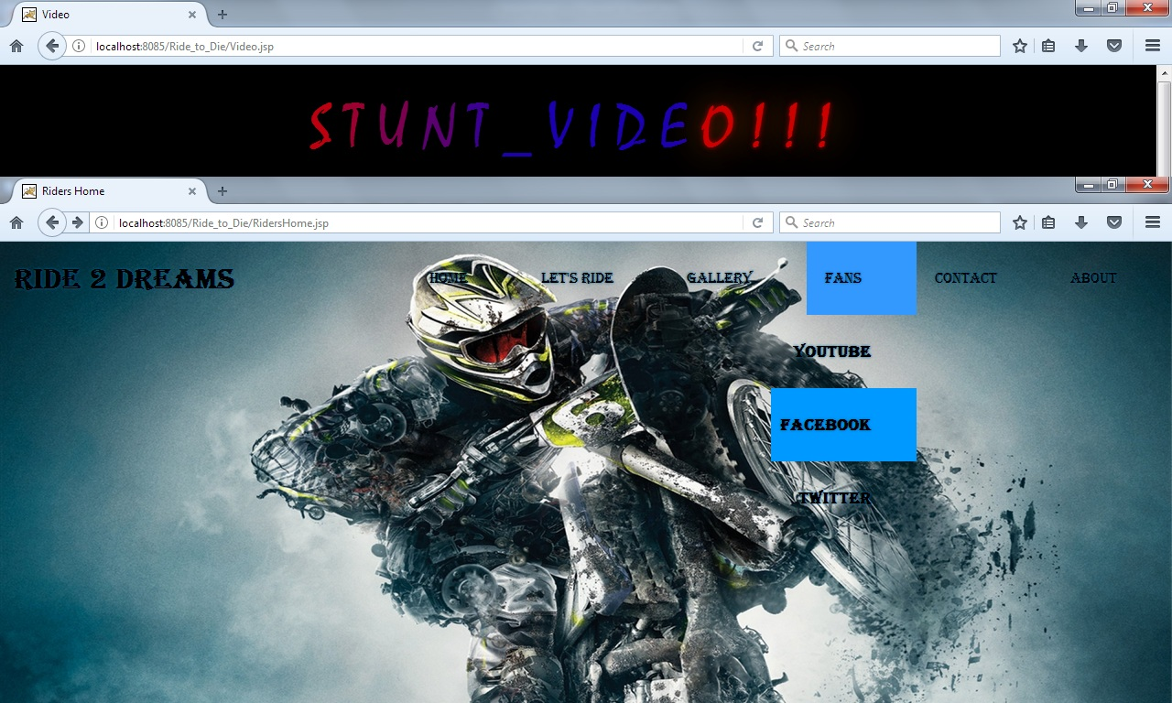
Fans
Fans Page consist of Youtube, Facebook and Twitter , it will navigate
Directly to the respective page.

Slide 8
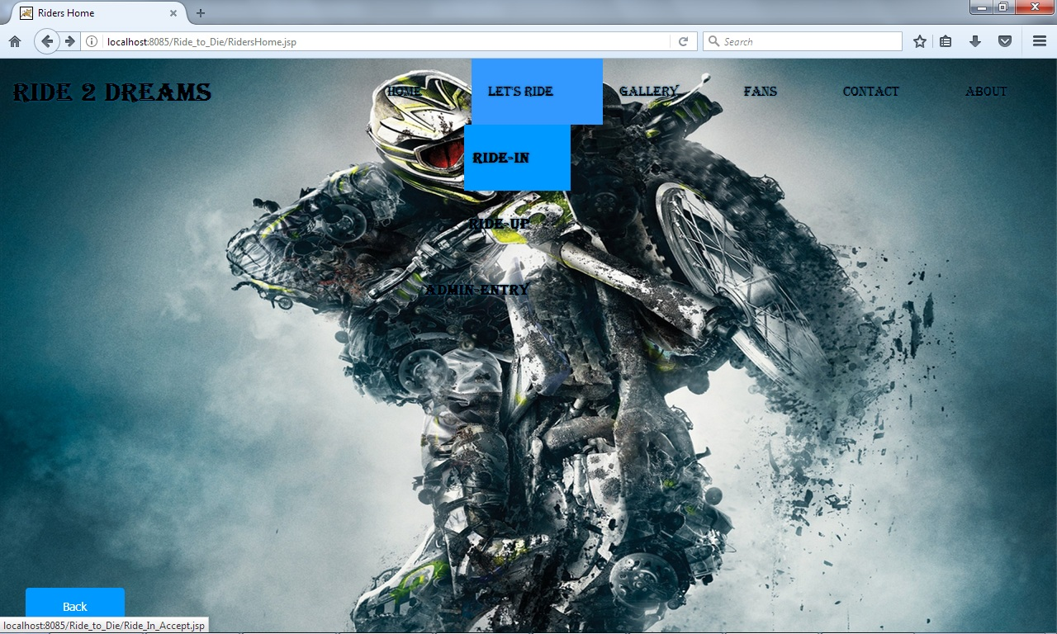
Let’s Ride
Let’s Ride In consist of Ride-In (Login) , Ride- Up(Registeration) and
Admin-Entry(Admin).

Slide 9
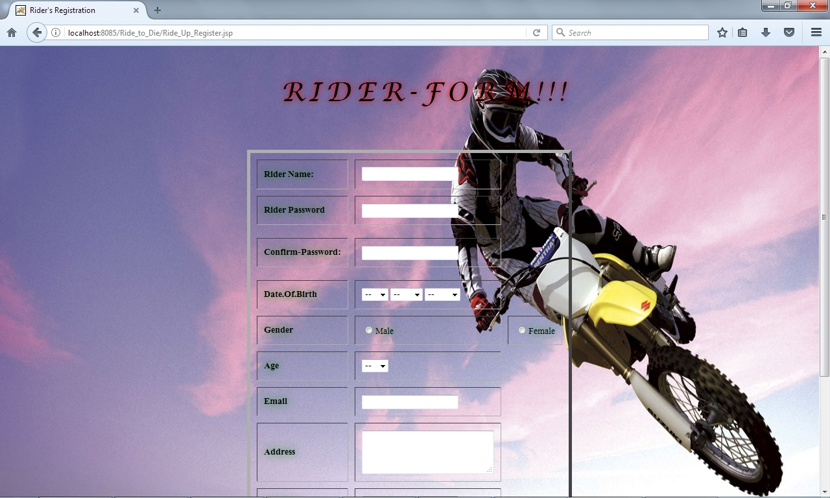
Ride-Up:
Ride-Up Page Consist of Registeration Form , rider can register by using
Ride-Up.

Slide 10
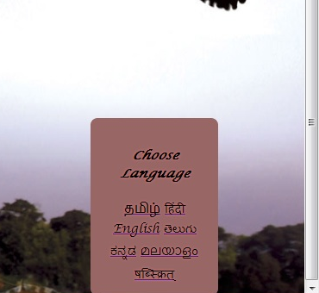
Register ation Page I18N
Registeration page is implement I18N with 7 Language for better
Understanding for Riders.

Slide 11
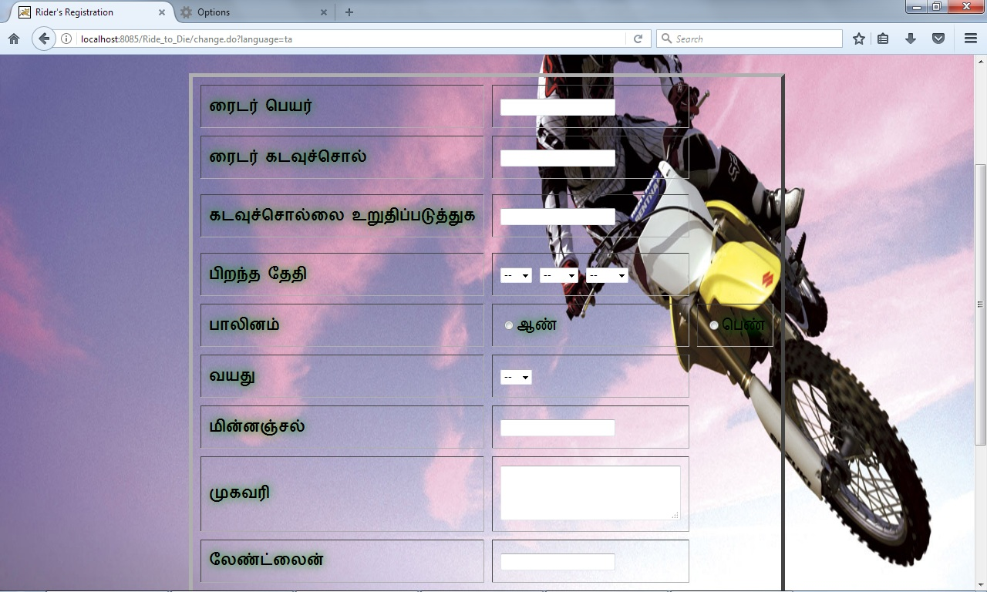
Registeration Page I18N Example

Slide 12
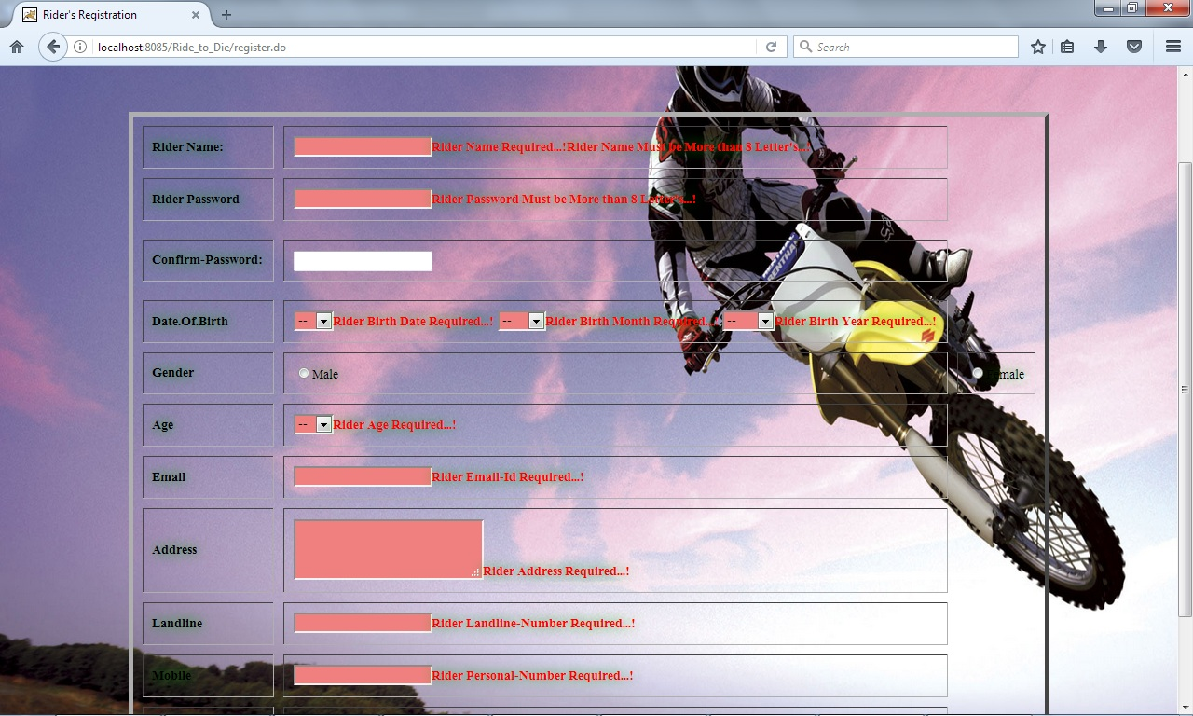
Ride-Up Validation:
Registeration Page is Validated by Using Struts Validation. There is some
Procedure to do Registeration.

Slide 13
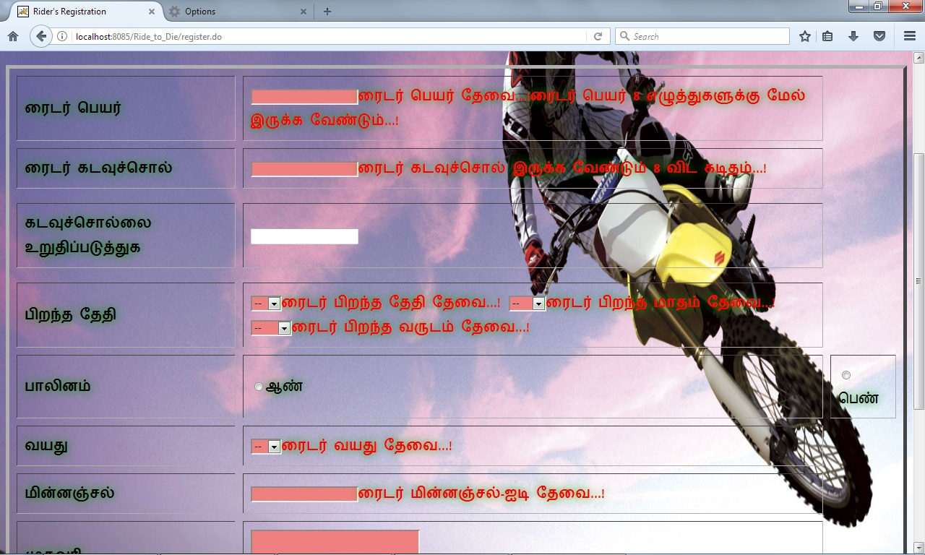
Registeration Validation I18N

Slide 14
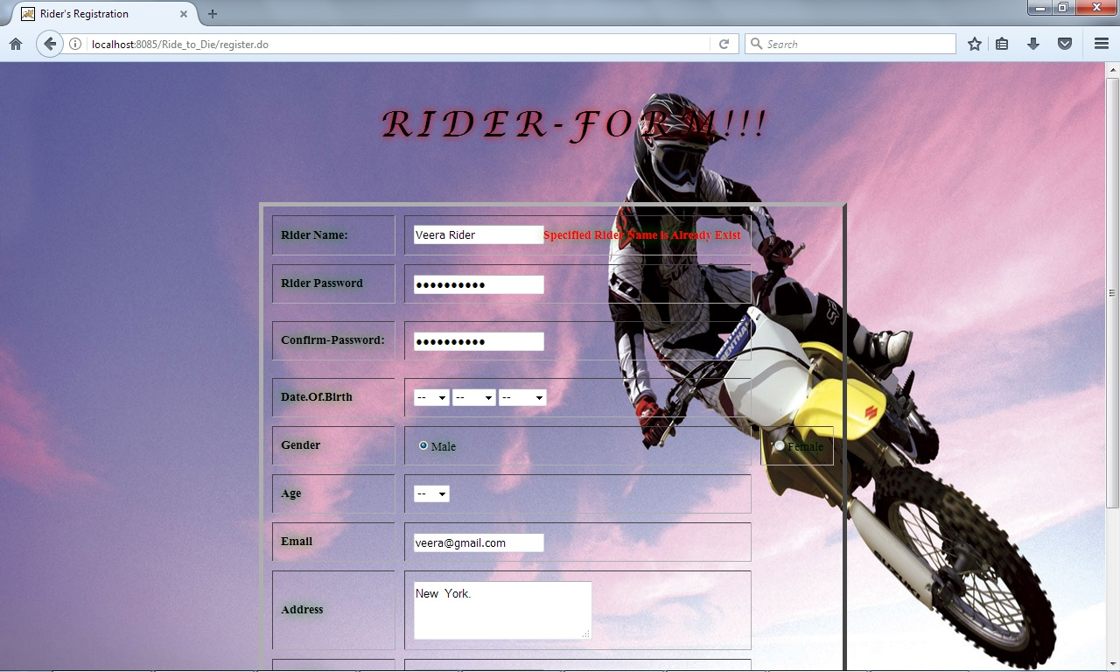
Rider Name Exist:
Rider Name is a Unique , once a Rider Name is Used and it can’t be used another
Time to register , if used it will display an error message “ Specified Rider Name is
Already” exist.

Slide 15
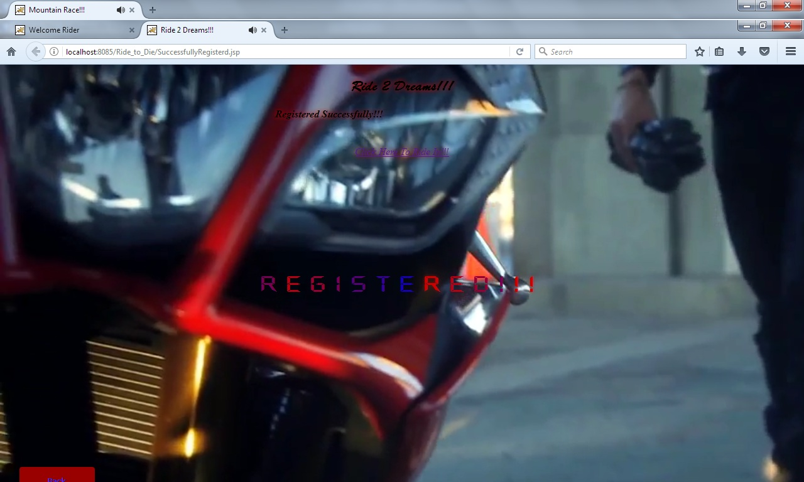
Success
If Rider Register Successfully it will navigate to another Page, showing
the Successfully Registered and a link appear to navigate to login page.

Slide 16
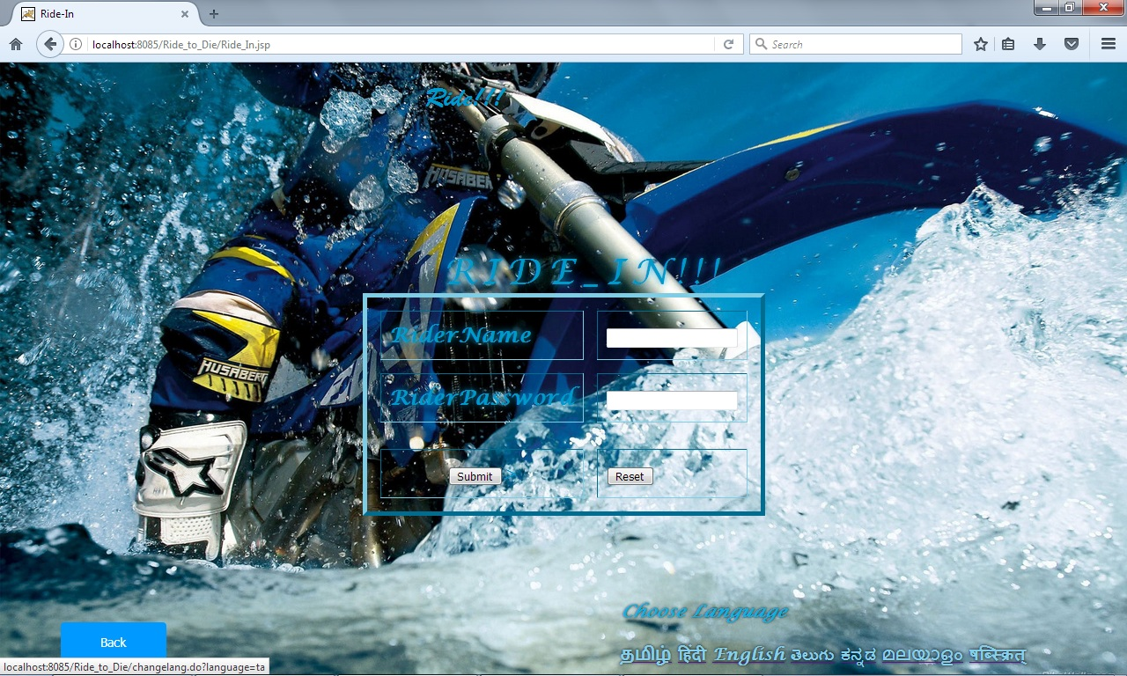
Ride-In:
In Ride-In Page , rider can login using thier respective username and
Password.

Slide 17

Ride In I18N
The Login Page is Implemented I18N with 7 Language for better Understanding
for the Riders.
I18N Example:

Slide 18
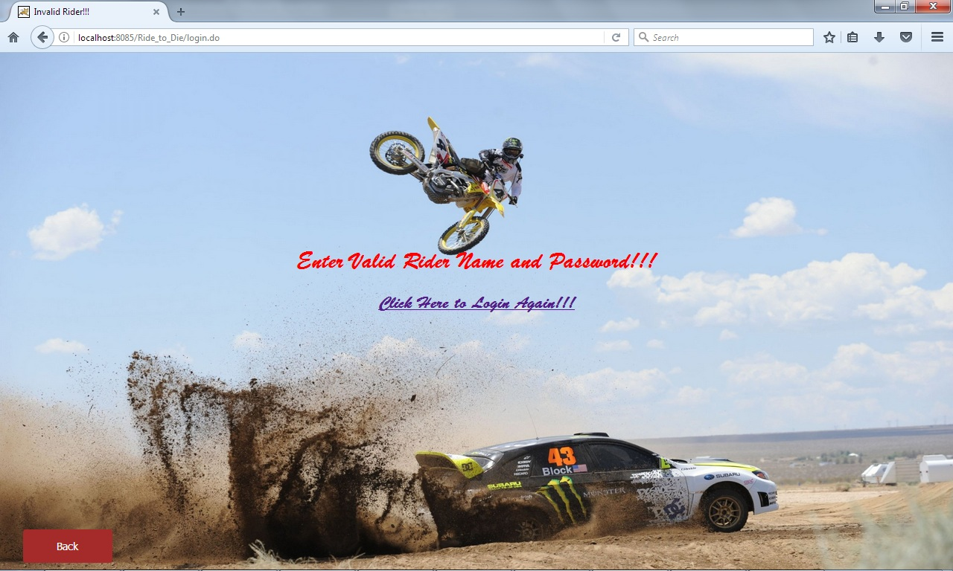
Invalid Rider:
If Rider Name and Password is not matched rider will redirect to an
Error Page.

Slide 19
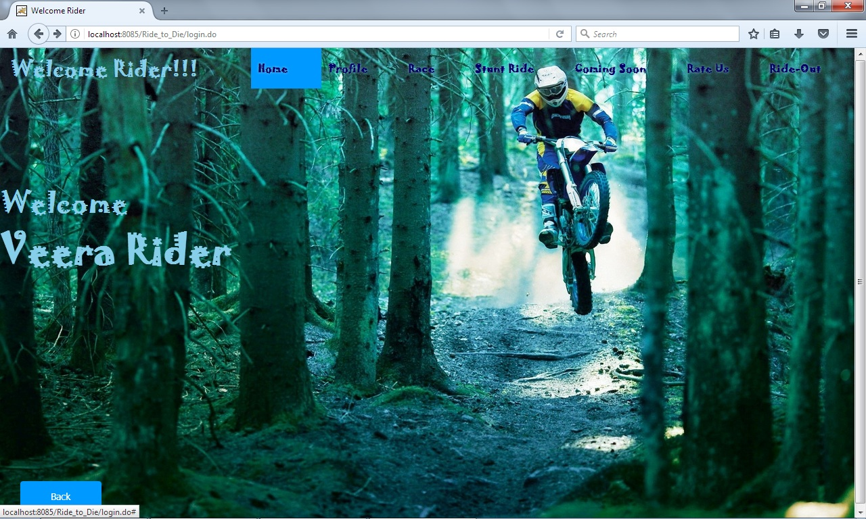
Welcome Rider
If RiderName and Password match the rider will redirect to the Welcome Page.
It consist lot of features , which will attract a rider.

Slide 20
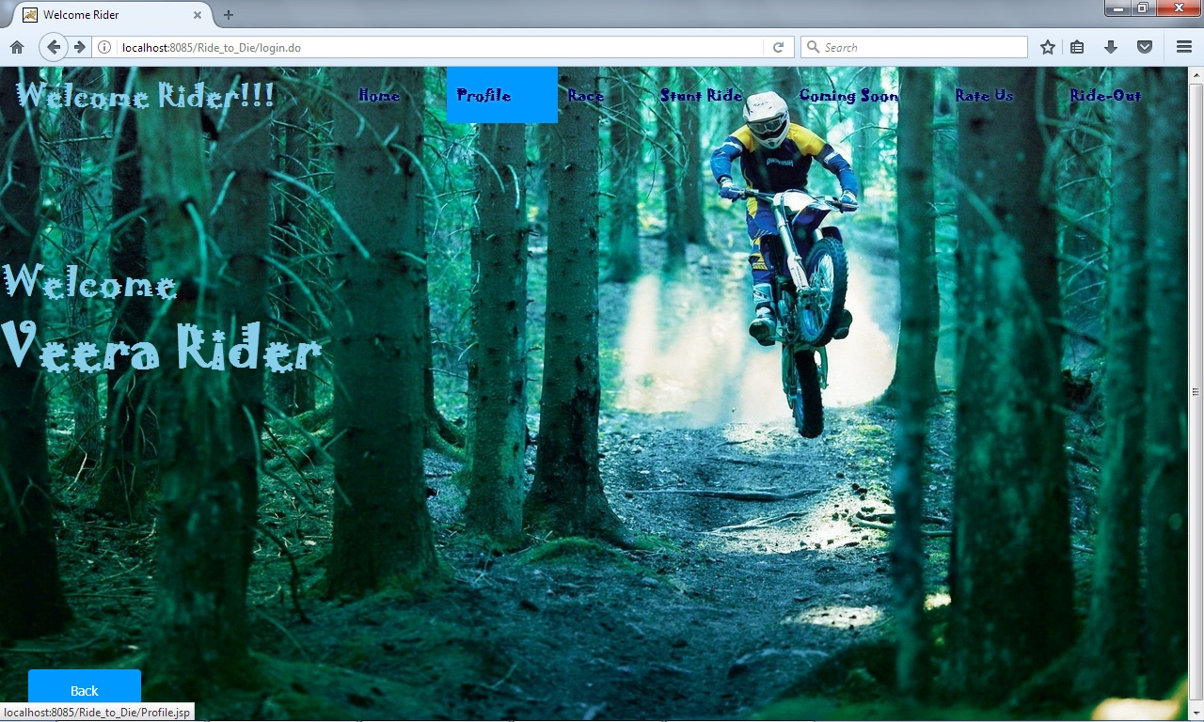
Rider Profile
To View the Rider Profile , the information entered during the registeration is displayed.

Slide 21
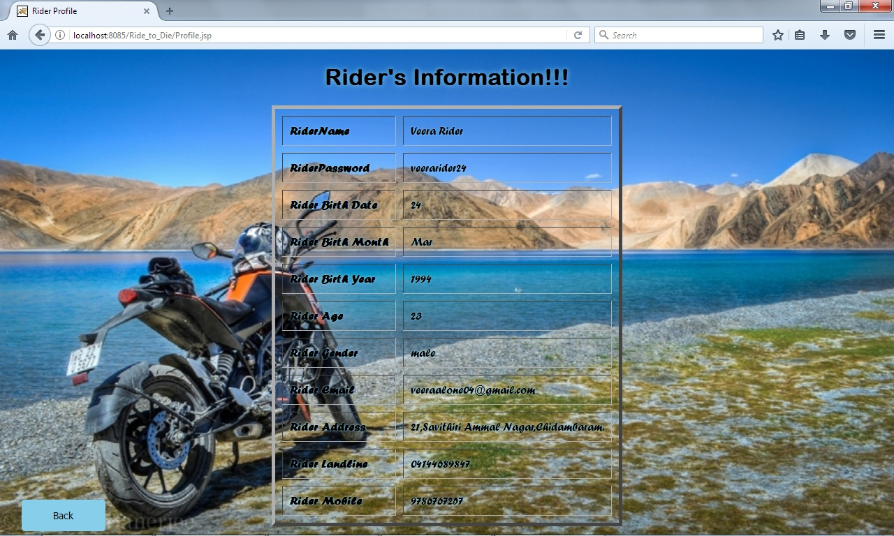
Profile
This page is implemented Database Tags and Expression Language to view the profile in
the JSP Page.

Slide 22
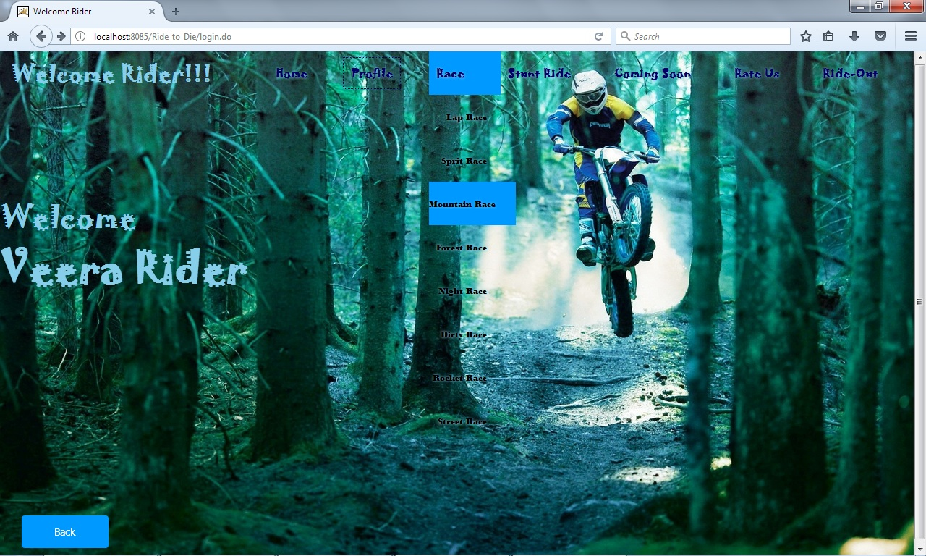
Race
The Race option consist lot of races which is conducted
and all the race are provided with a video , so it is so much attractive
to rider.

Slide 23
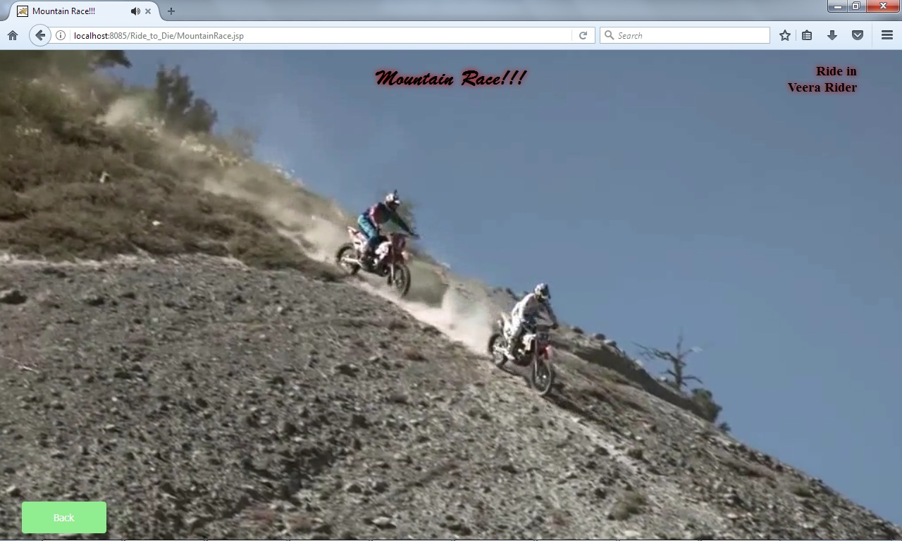
Race Example:

Slide 24
Tag Handler
By Using Tag Handler the rider name is implemented in all the Page of
right side.

Slide 25
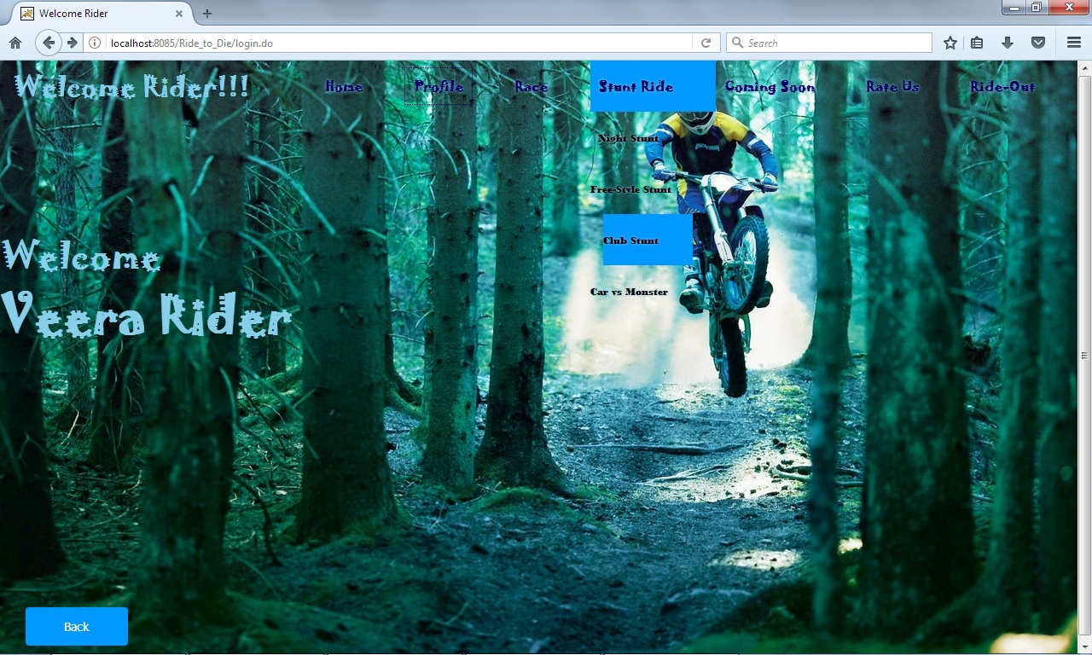
Stunt

Slide 26
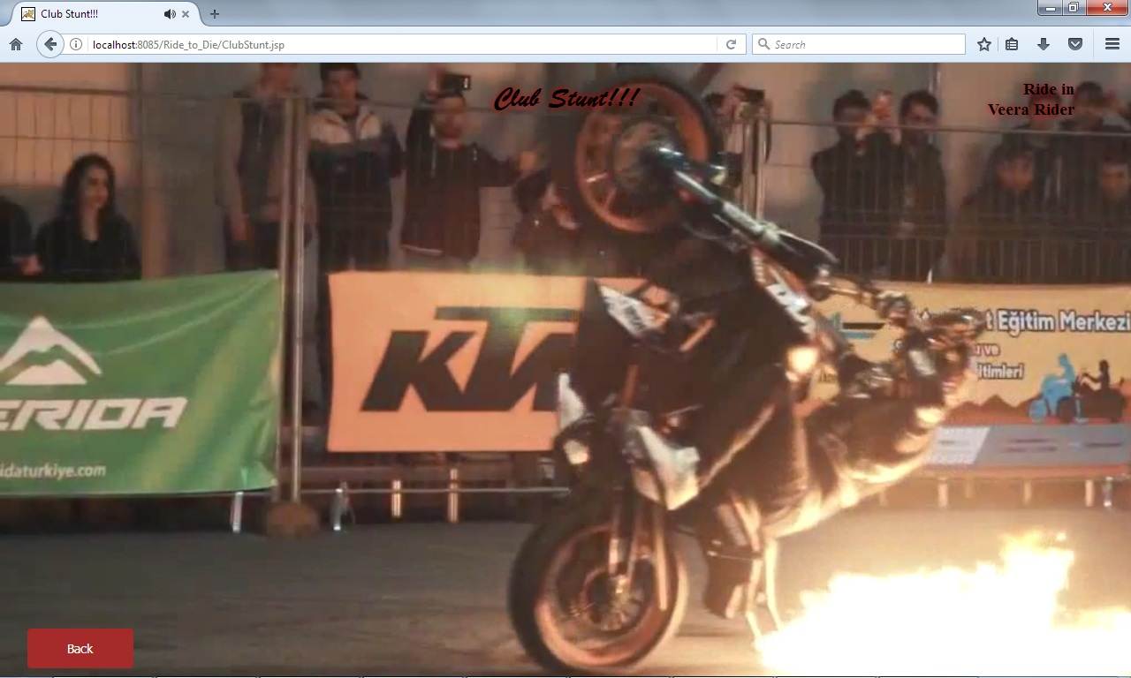
Stunt Example

Slide 27
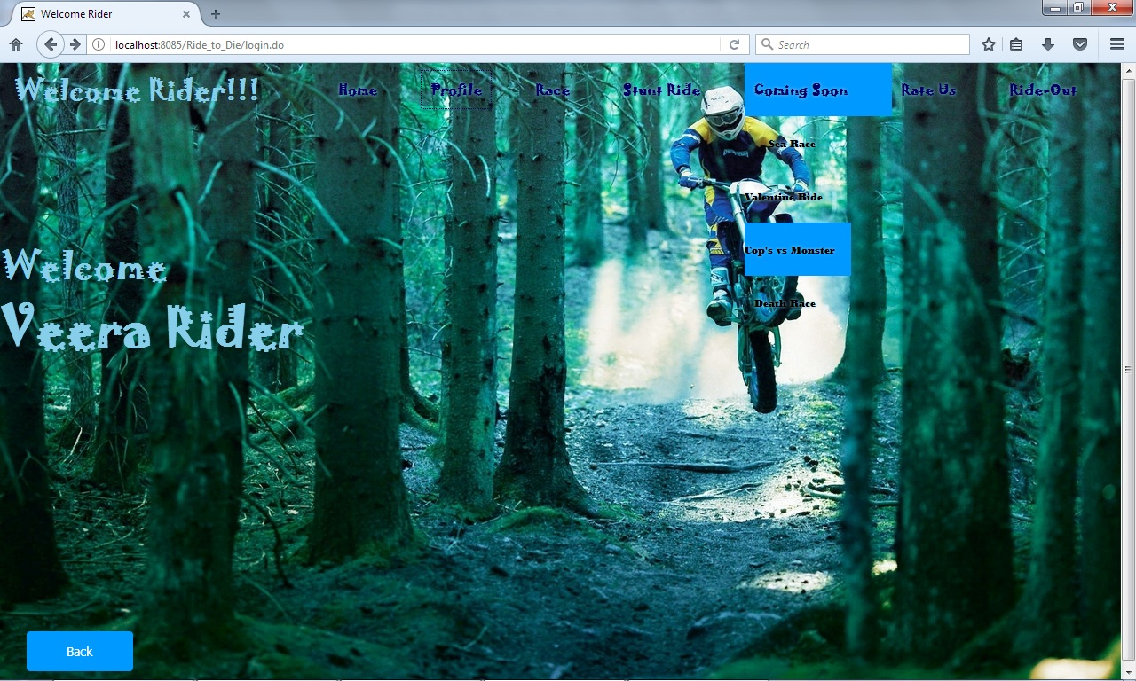
Coming Soon

Slide 28
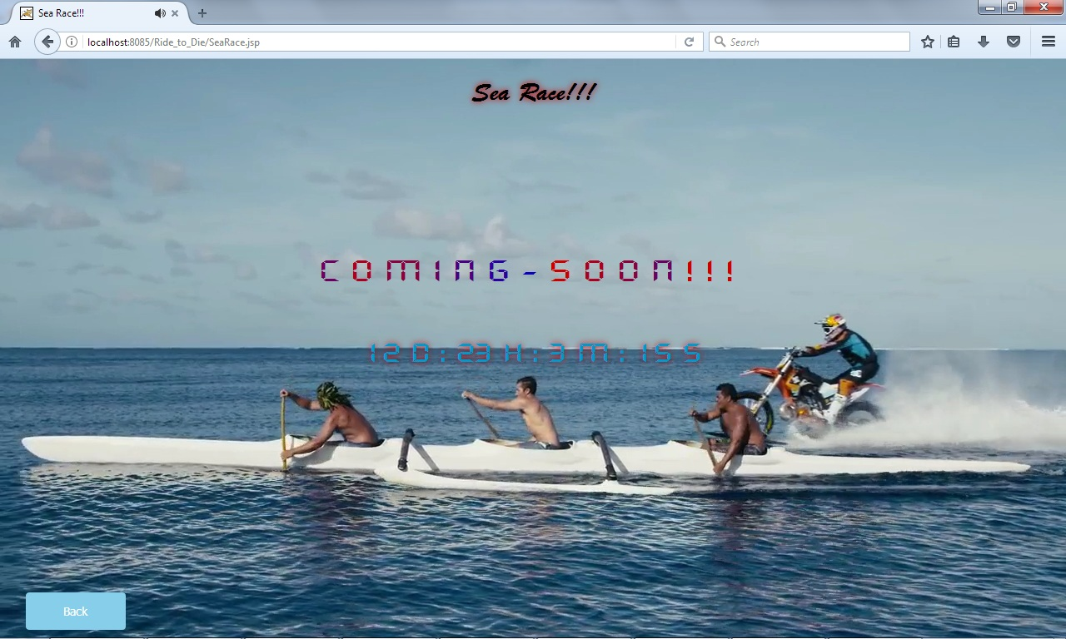
Coming Soon Example
This Page is designed by HTML,CSS and JavaScript, CountDown Timer is
added additional to convey that the race are coming in that time.

Slide 29
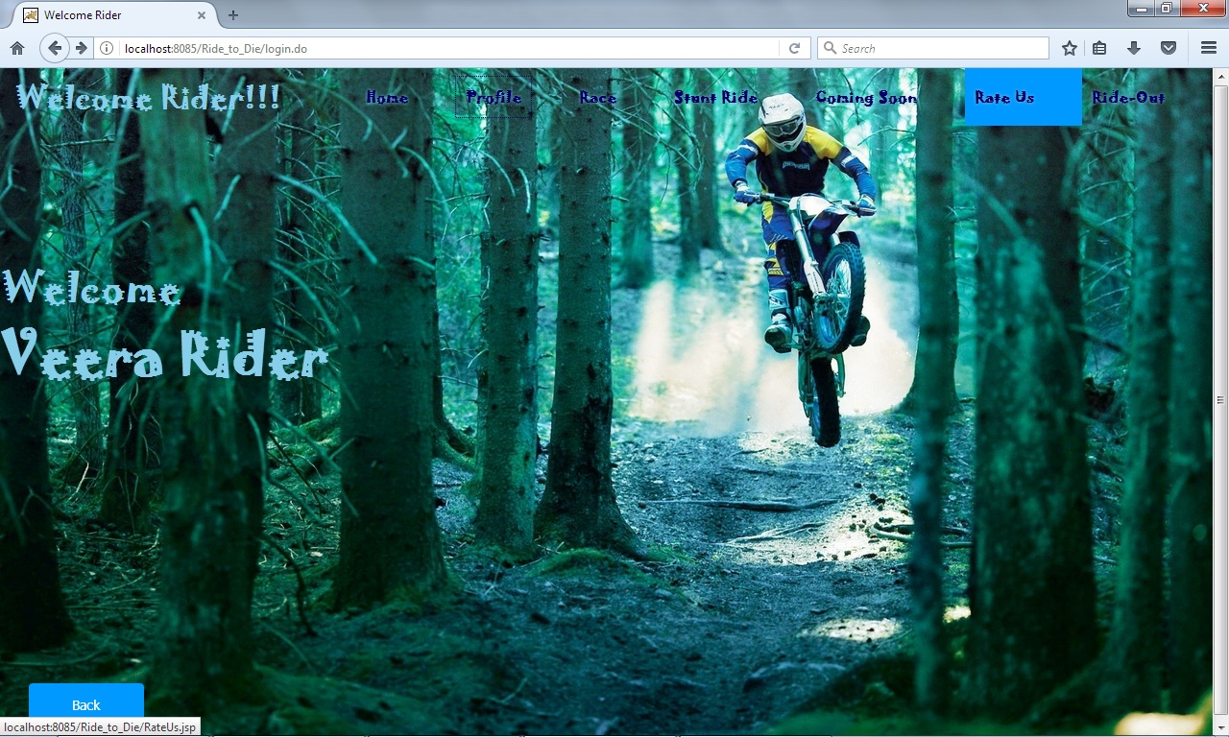
Rate_Us:

Slide 30
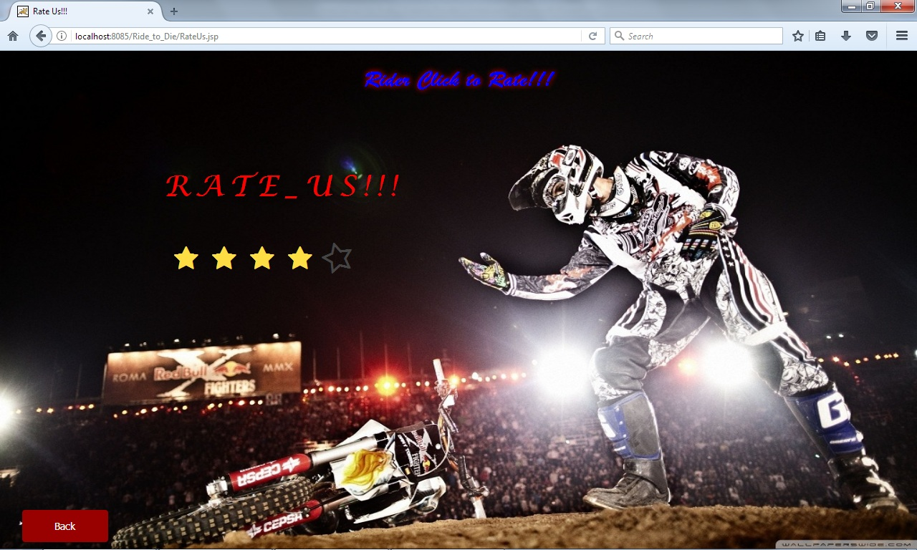
Rate

Slide 31
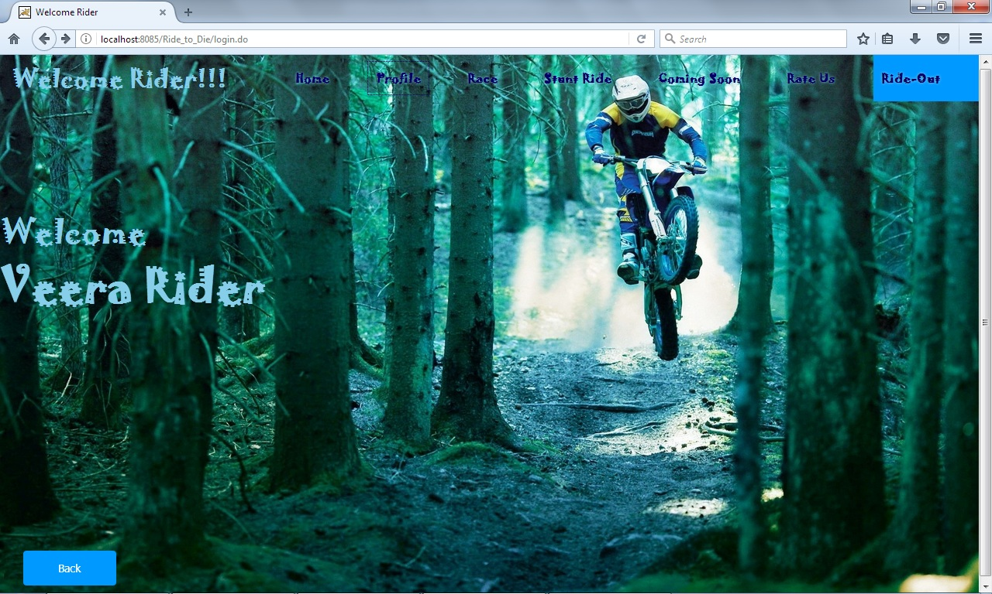
Ride – Out
This Link is used to ride-out(logout) from your profile to the Home Page
of the Web-Site.

Slide 32
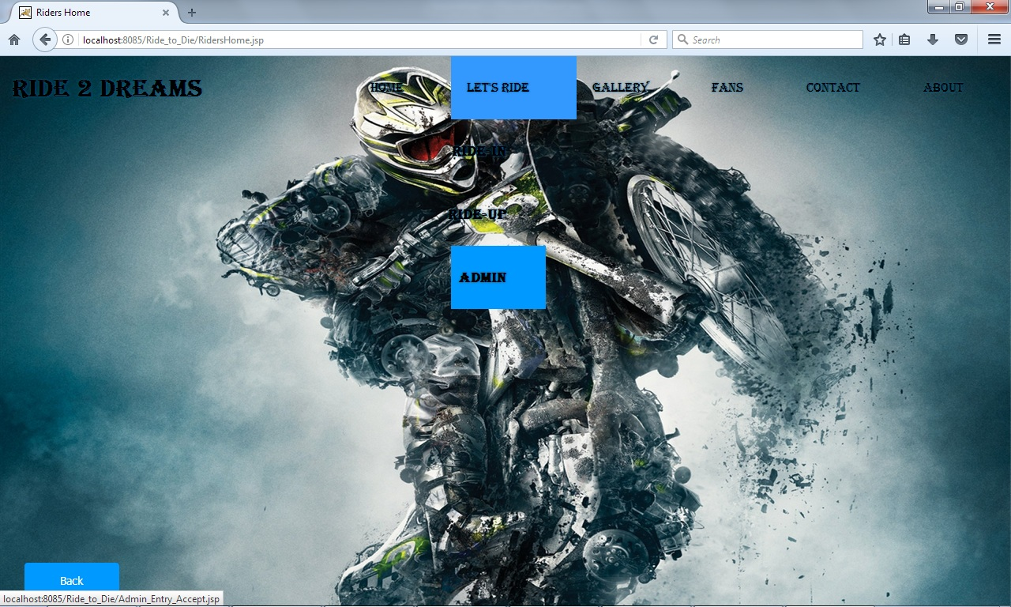
Admin
Admin has the authorization to delete , insert , view rider from the
Ride 2 Dreams website, admin name and password are Hard-Coded.

Slide 33
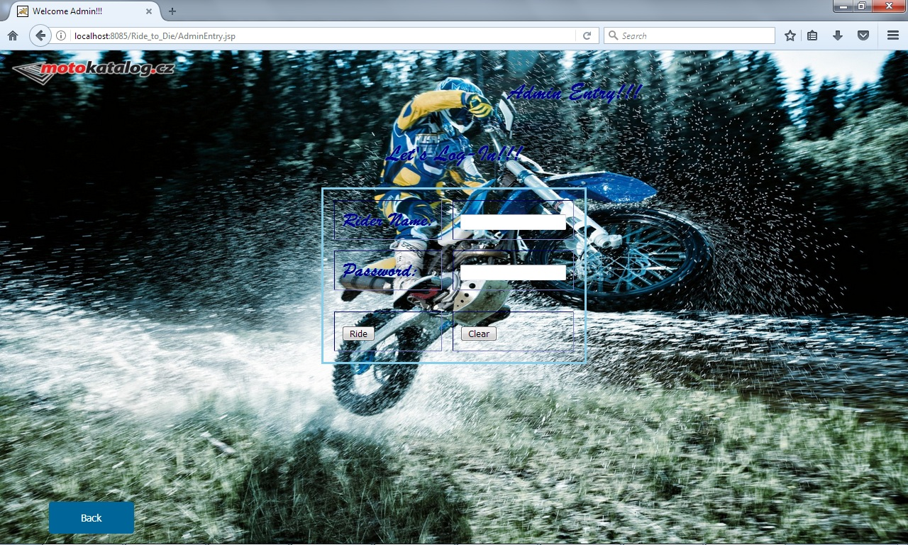
Admin Entry:
Login page for Admin.

Slide 34
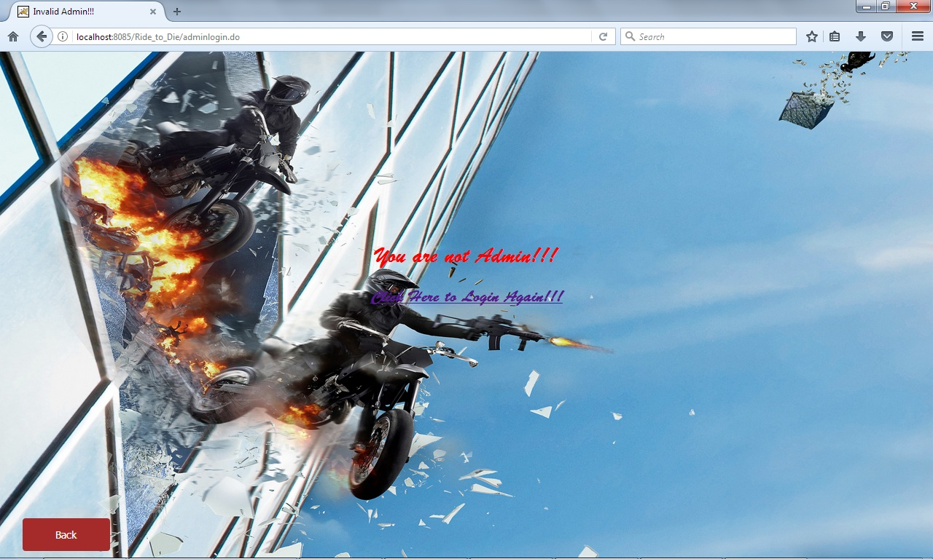
Invalid Admin:
If the admin name and password are mismatch its redirect to an Error
Page.

Slide 35
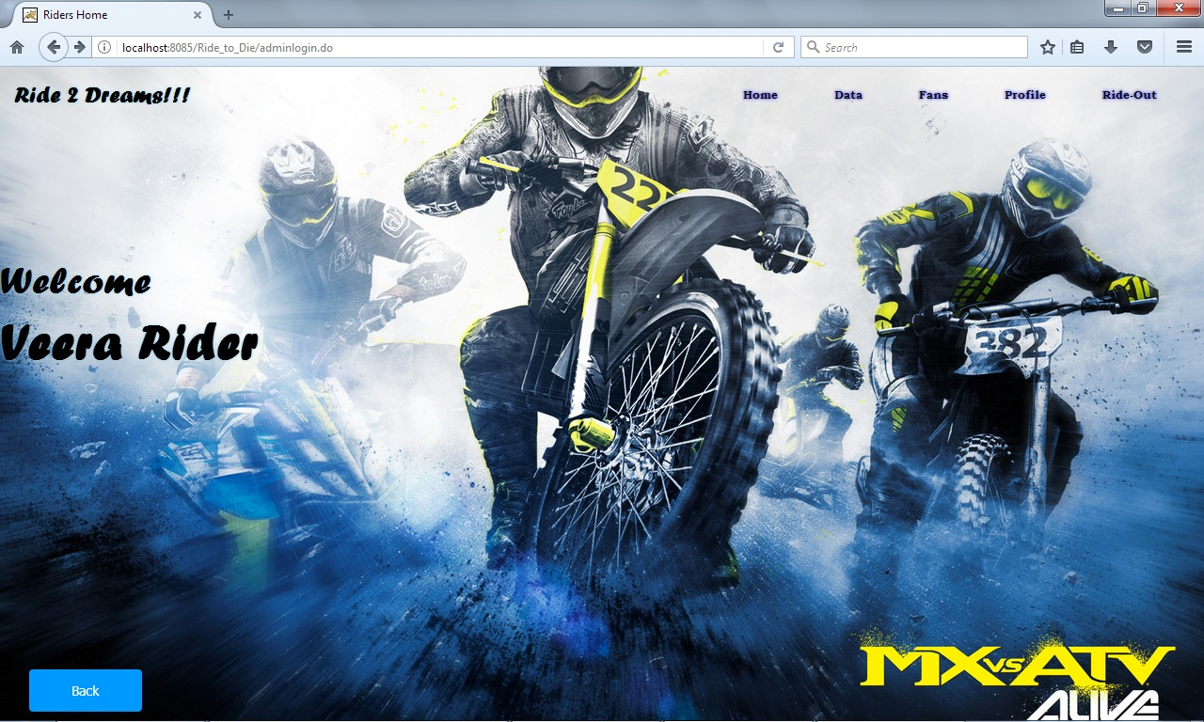
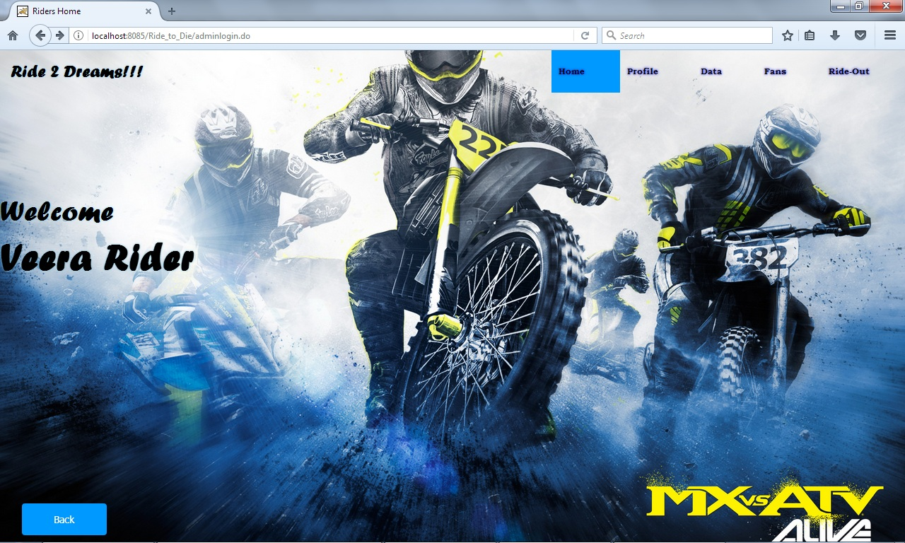
Welcome Admin

Slide 36
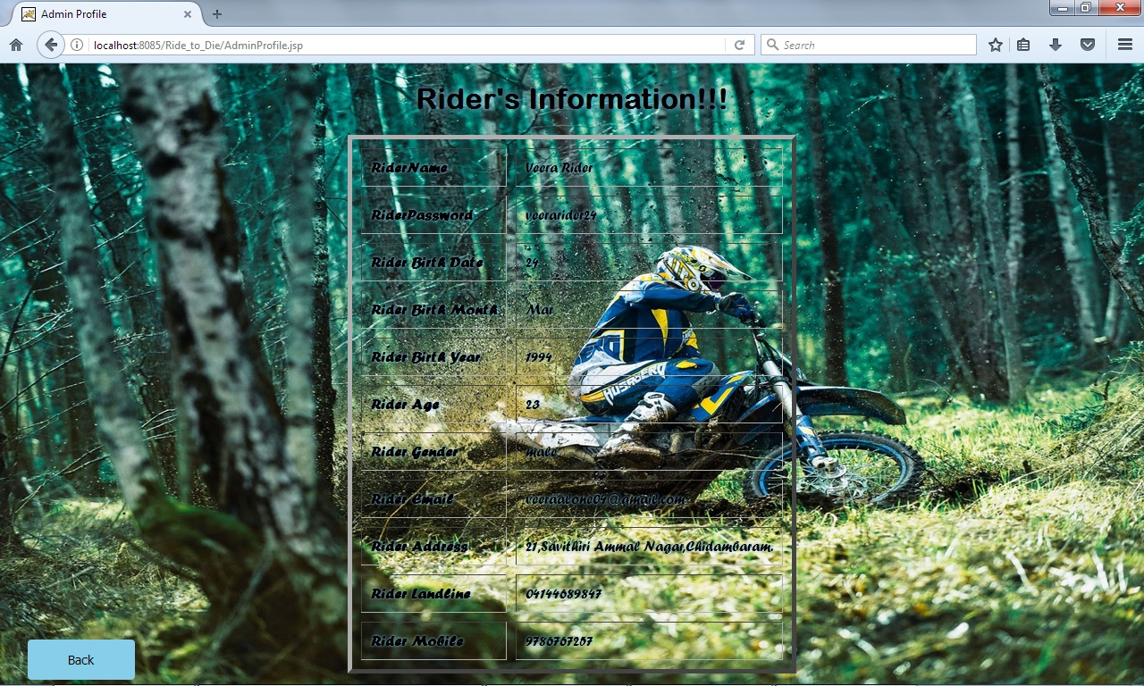
Admin Profile

Slide 37
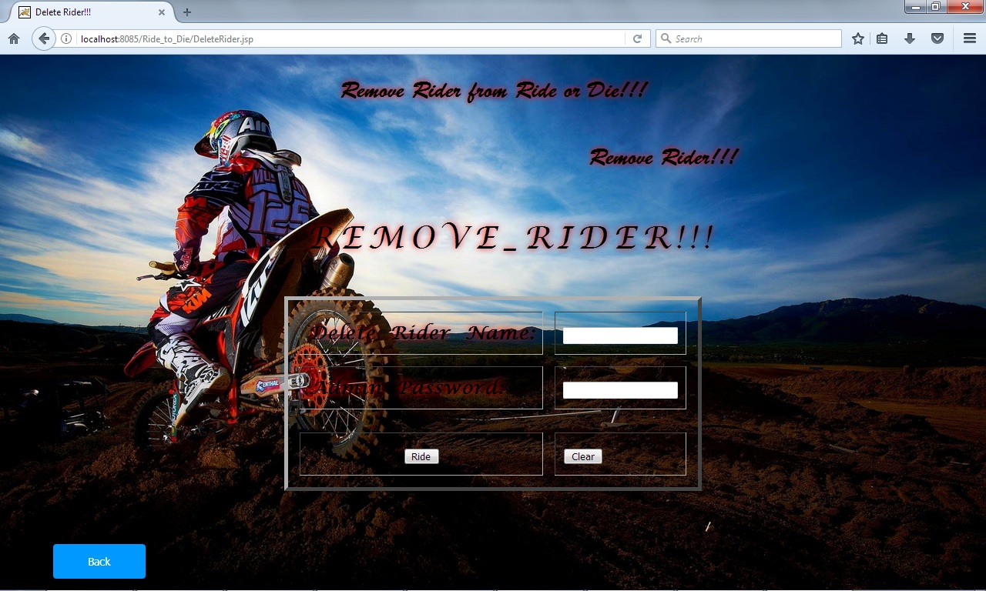
Remove Rider
Admin has the authority to remove the Rider.

Slide 38
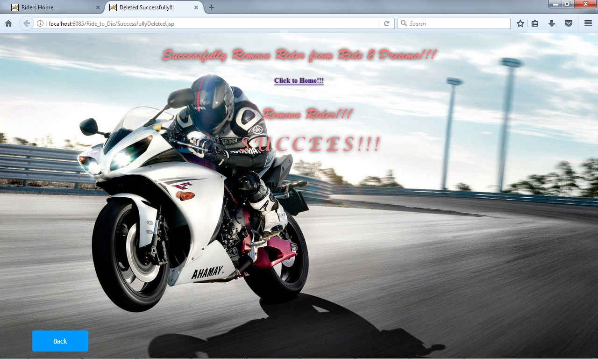
Removed Successfully

Slide 39
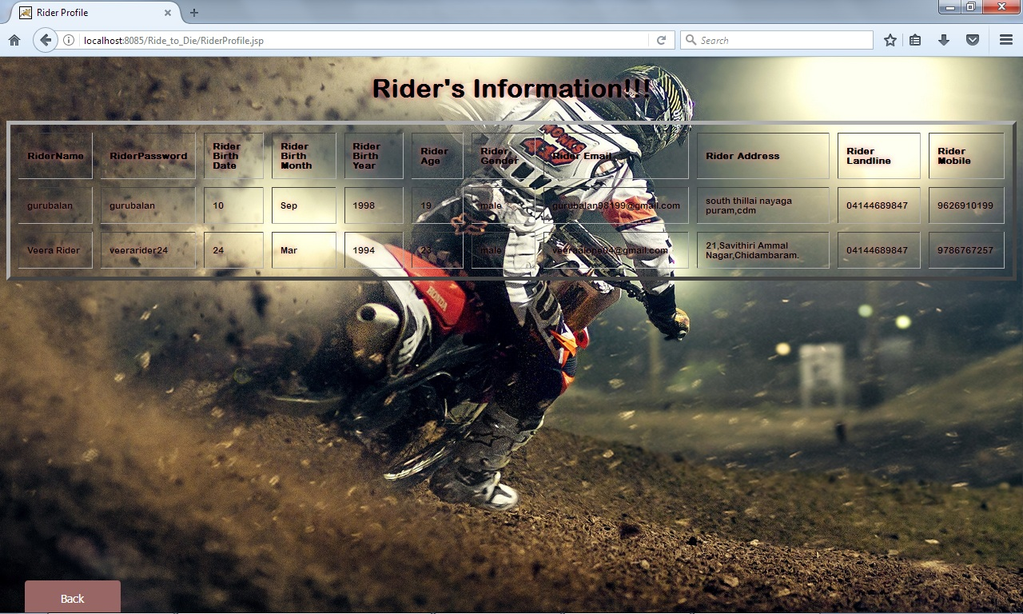
Rider Information
This Page Provide Rider’s Information to admin from database.

Slide 40
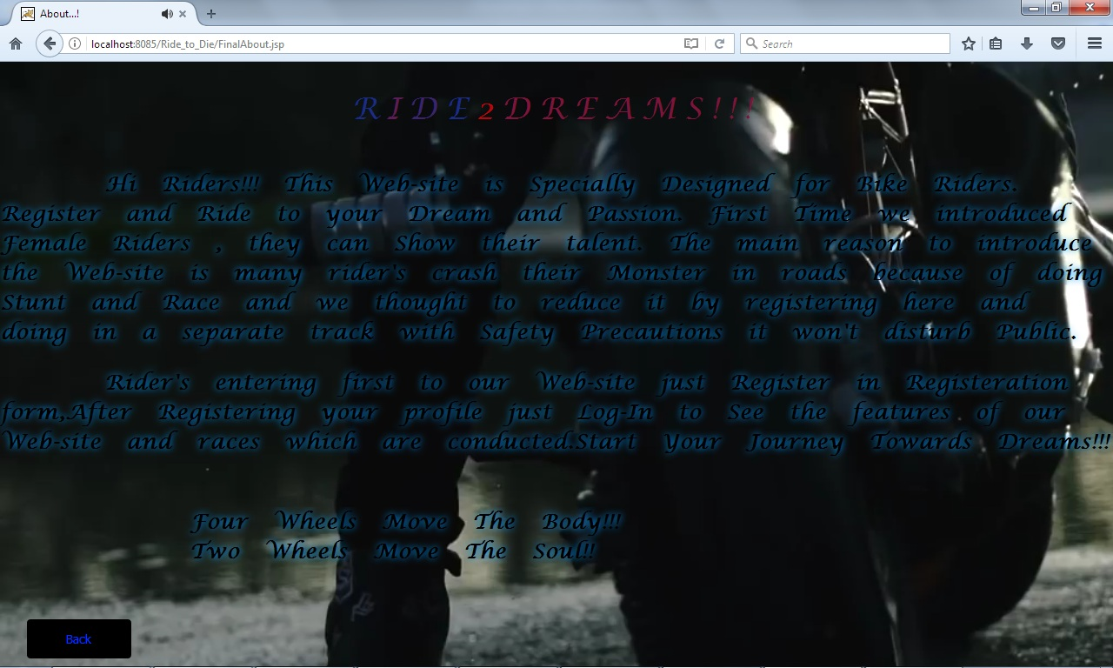
About
The About Page Contains the information about the Website. It also contains
the background video , glowing text of “Ride 2 Dreams” , Marquee Text
which which scroll on the page and back button is placed to navigate previous
Page.

Slide 41
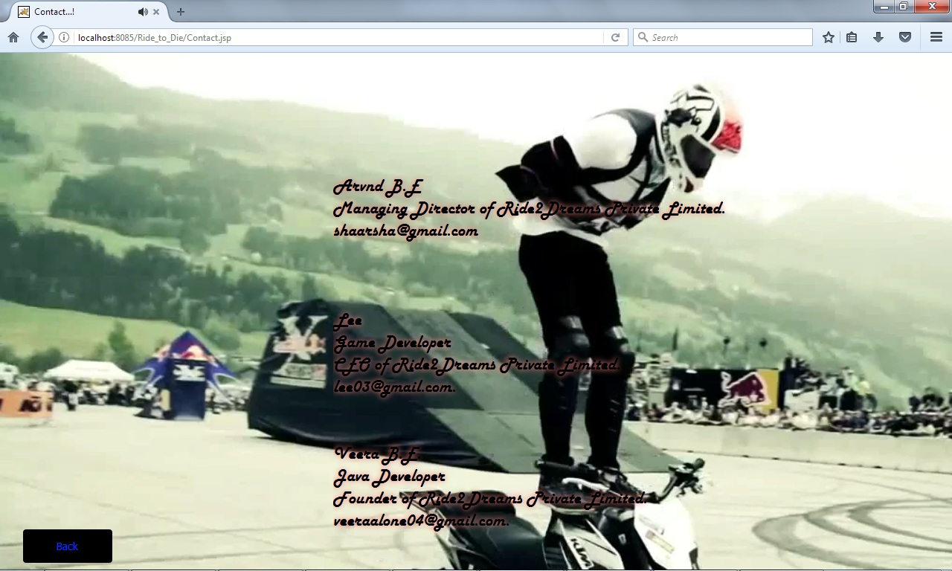
Contact
Contact Page Consist of information whom to contact for further details.
This Page is designed by using marquee text, background video and a back
Navigation button.

Slide 42
Thank You

